Slide 1
Blockchain-Based Land Registration System
CSE7101- Capstone Project
Review-1
Batch Number: 20221CBC(CBC_3)
Under the Supervision of, Mr.Shankar J
Mr.Shankar J
Assistant Professor
School of Computer Science and Engineering
Presidency University
Roll Number | Student Name
20221CBC0005 | Varsha BR
20221CBC0048 | Sandya KJ
20221CBC0051 | C.Lokesh
Name of the Program: B.Tech
Name of the HoD: Dr. Pravinthraja S
Name of the Program Project Coordinator: Dr. H M Manjula
Name of the School Project Coordinators: Dr. Sampath A K

Slide 2
Problem Statement Number: PSCS_4
Organization::Ministry of Jal Shakti
Category (Hardware / Software / Both) :SOFTWARE
Problem Description:Current land registration systems are prone to fraud, delays, and lack of transparency.Manual record-keeping leads to disputes and high verification time.Need for a tamper-proof, transparent, and efficient solution.

Slide 3
Content
Problem Statement
Proposed Solution
Objectives
System Architecture
System Requirements
Workflow Diagram
Advantages
Challenges & Solution
Git-hub Link
Conclusion & Future Scope
References

Slide 4
Content (continuation)..
Problem Statement :Current land registration systems are prone to fraud, delays, and lack of transparency. Manual record-keeping leads to disputes and high verification time.Need for a tamper-proof, transparent, and efficient solution.
A solution is needed to:
Blockchain-Based Land Registry
Smart Contracts for Transactions
Decentralized Access & Transparency

Slide 5
Objectives
Provide a secure and transparent platform.
Reduce registration time and disputes.
Enable decentralized data storage to prevent tampering

Slide 6
System Architecture
Frontend: HTML, CSS, JavaScript (React/Angular optional)
Backend: Node.js / Express
Blockchain: Ethereum (Testnet / Private Network)
Database: IPFS + MongoDBSmart
Contracts: Solidity.

Slide 7
Software Requirements
OS: Windows / Linux / MacOS
WebBrowser: Chrome / Firefox
Node.js & NPM
Ganache / Truffle for blockchain development
MetaMask extension

Slide 8
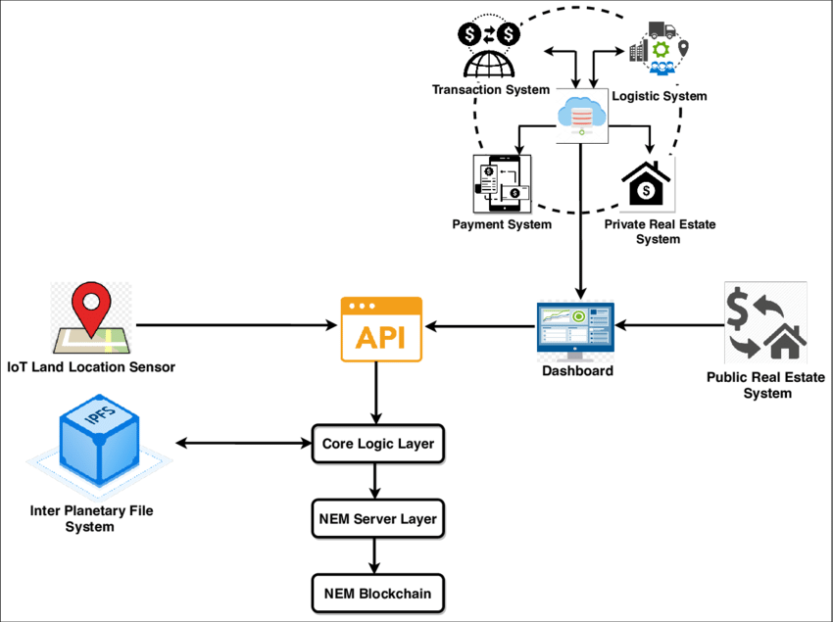
WorkFlow Diagram
WorkflowUser Login
via MetaMask.
Property Registration form
submission with documents.
Smart Contract Validation
and hash generation.
Blockchain Storage of
transaction hash.
Ownership Transfer upon
buyer-seller agreement

Slide 9
Advantages
High security & transparency.
Reduced fraud & paperwork.
Immutable transaction history.
24/7 accessibility from anywhere.

Slide 10
Challenges & Solutions
Challenge Solution
High gas fees Use private blockchain or Layer-2 solutions
User adoption Provide training and easy-to-use UI
Large file storage Store only file hashes on blockchain and actual files in IPFS

Slide 11
Github Link
The Github link provided should have public access permission.
Github Link
https://github.com/ANUSHA474-ai/CAPSTONE_PSCS_4_waterfootprint-calculator-for-daily-usage-products
https://github.com/Shree336/CAPSTONE_PSCS_4_waterfootprint-calculator-for-daily-usage-products

Slide 12
Conclusion & Future Scope
Can integrate with government databases for real-world adoption.
Potential to expand into multi-country land management systems.
Future integration with AI for fraud detection.

Slide 13
References (IEEE Paper format)
https://tijer.org/JNRID/papers/JNRID2411012.pdf
https://link.springer.com/article/10.1007/s11540-024-09716-1
https://watercalculator.org

Slide 14


